Slide 1
OT PLATFORM / EXECUTIVE DEMO
Operational clarity
for OT security
01
ESTATE
02
EXPOSURE
Bring asset visibility, threat context, audit evidence, and operational risk into one working view.
03
EVIDENCE
04
PRIORITY
A management walkthrough of what is visible, what is verified, and where a human decision remains essential.
OT PLATFORM / MANAGEMENT DEMO
01

Slide 2
01 / MANAGEMENT VALUE
Move from scattered signals to shared context
The platform connects security evidence to the operational questions leaders ask.
See the estate
Prioritize exposure
Explain the evidence
Track the work
Live OT device inventory, connectivity, site filters, and device-level context.
Vulnerability severity and CVE context alongside asset risk and business impact.
Source-aware events, local indicator matches, and searchable investigation records.
Audit assignments, workbook revisions, response dry-runs, and readiness gaps.
Leadership outcome
A clearer view of coverage, exposure, evidence quality, and the next accountable step.
OT PLATFORM / MANAGEMENT DEMO
02

Slide 3
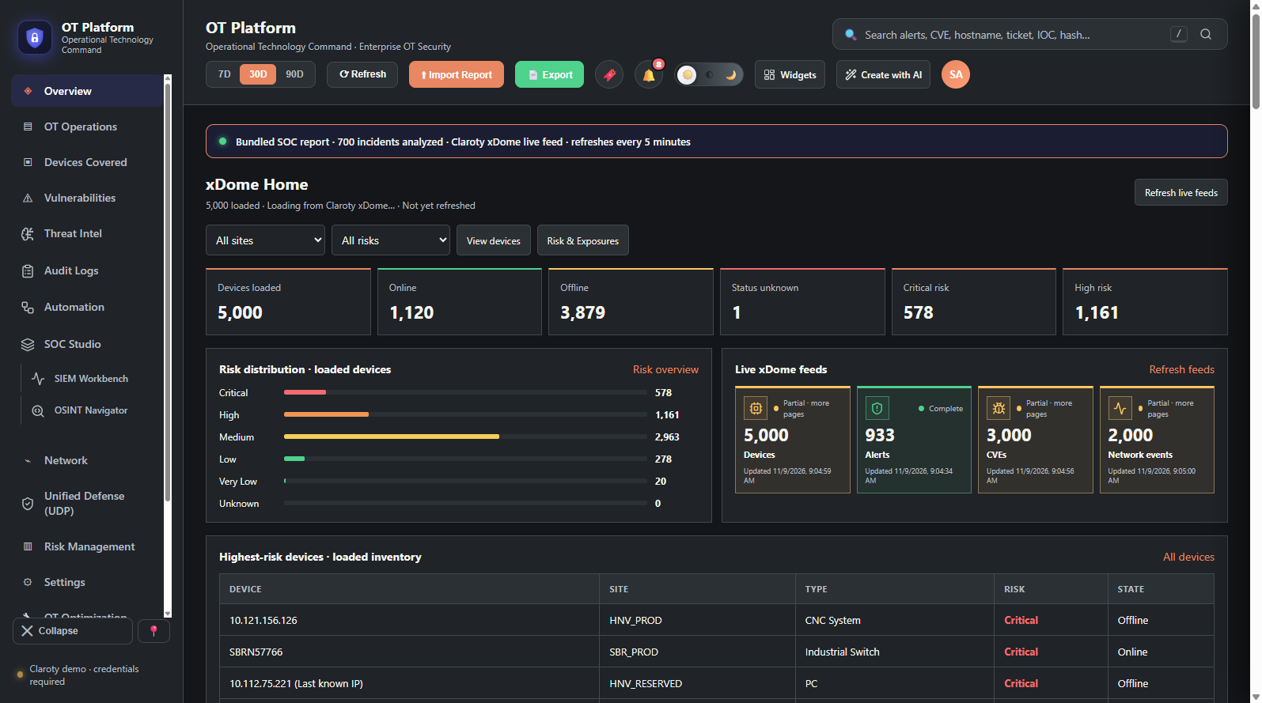
01 / DASHBOARD WALKTHROUGH
Executive overview
Estate, risk and feed status in a single landing view.
Management value
Quick read of asset counts, connectivity, risk distribution, and feed completeness.
Interpretation
This capture shows demo content and indicates Claroty credentials are required. Validate the tenant connection before using any count as an operational measure.
Device-level identifiers omitted from this presentation.
Illustrative UI capture · not verified client data
OT PLATFORM / MANAGEMENT DEMO
03

Slide 4
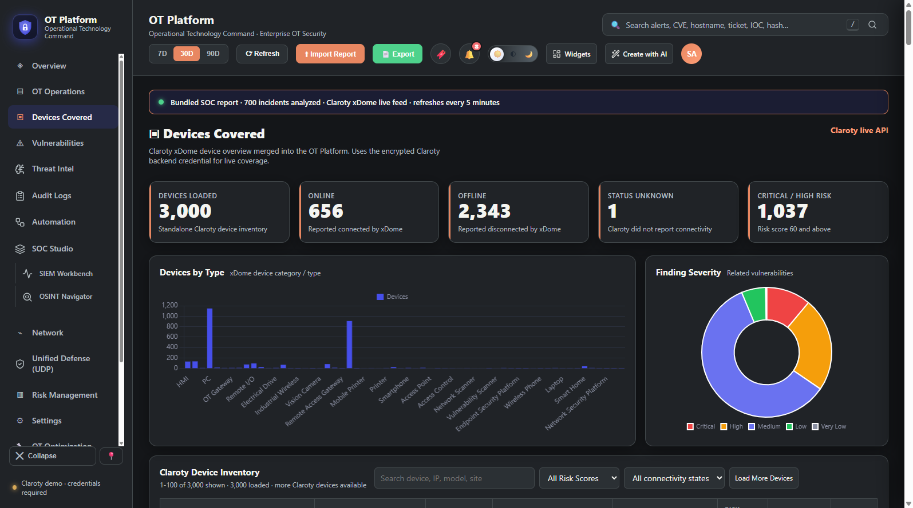
02 / DASHBOARD WALKTHROUGH
OT asset coverage
Inventory view for finding and inspecting connected OT assets.
Operational use
Review asset types, online state and risk; search or filter the inventory and drill into a device.
Interpretation
Loaded counts can be partial while more pages remain. Use site and owner context to prioritize follow-up; do not treat missing data as absence of risk.
Illustrative UI capture · not verified client data
OT PLATFORM / MANAGEMENT DEMO
04

Slide 5
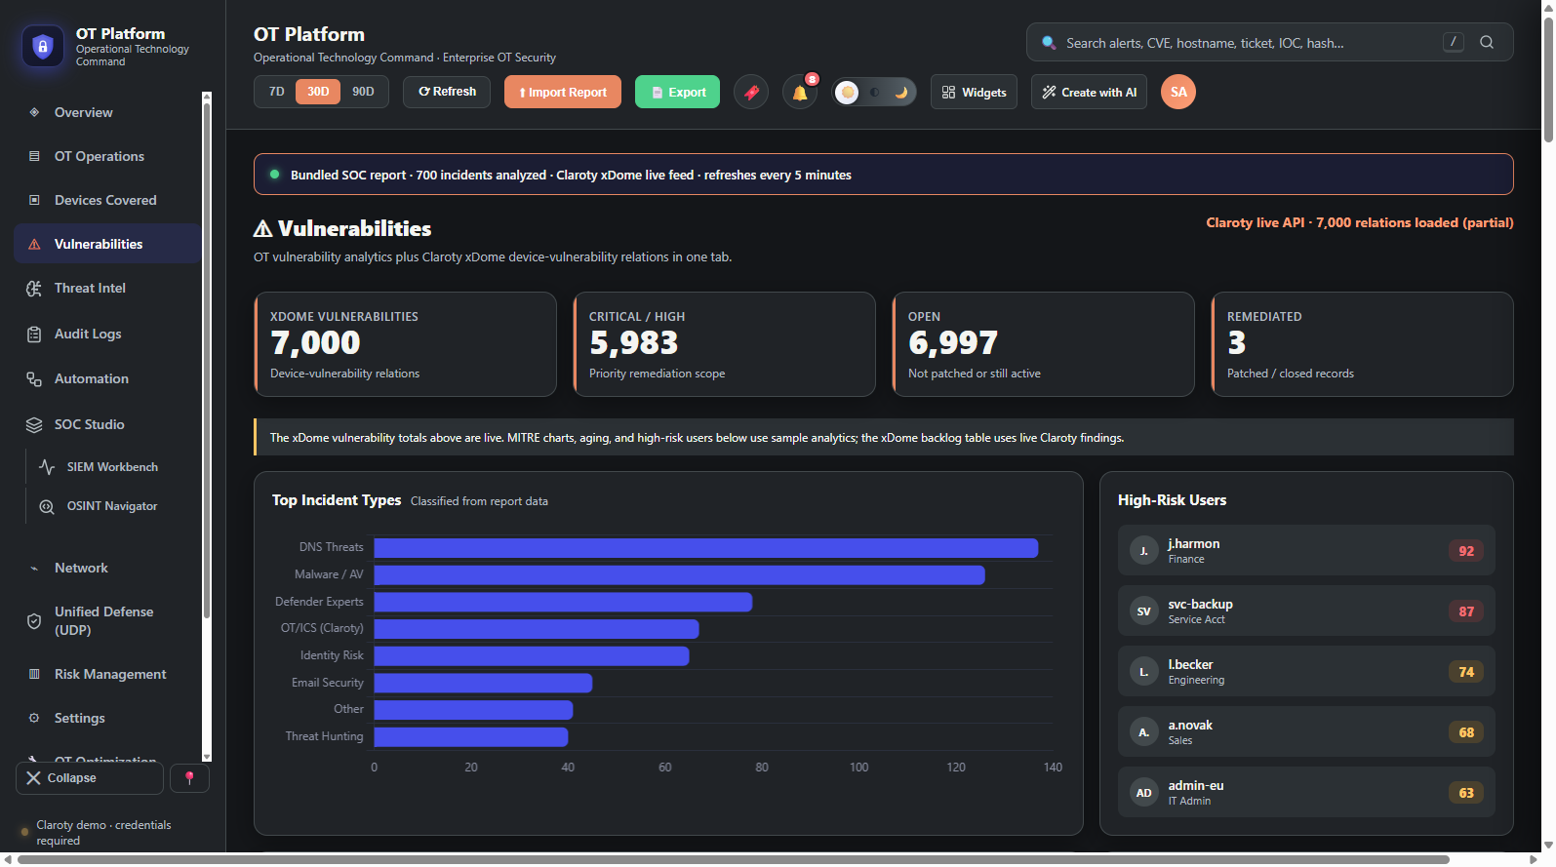
03 / DASHBOARD WALKTHROUGH
Vulnerability exposure
Connect device context to related findings and remediation status.
Management value
Focus reviews on critical/high findings and open exposure, then inspect the linked OT devices.
Interpretation
Live totals require a configured xDome connection. Adjacent MITRE, aging and user analytics are sample data and are labeled in the application.
Illustrative UI capture · not verified client data
OT PLATFORM / MANAGEMENT DEMO
05

Slide 6
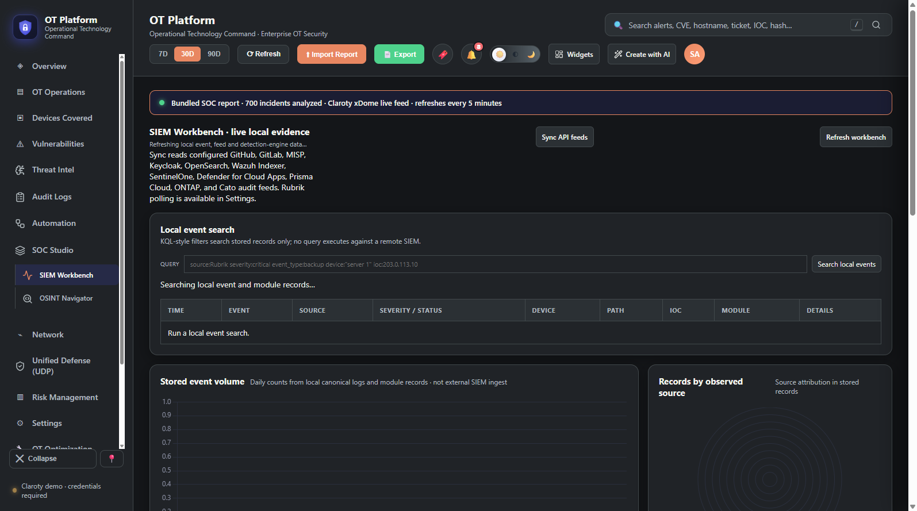
04 / DASHBOARD WALKTHROUGH
SIEM evidence workbench
Search and summarize evidence stored locally by this platform.
Analyst workflow
Sync configured read-only feeds, search normalized local events, and inspect source attribution and evidence health.
Interpretation
Search is limited to locally stored records; it does not query a remote SIEM. A configured credential is not proof of a tested connection.
Illustrative UI capture · not verified client data
OT PLATFORM / MANAGEMENT DEMO
06

Slide 7
05 / SECURITY AUDIT AND GOVERNANCE
Make review work visible and traceable
Capture assessment ownership, response evidence, review decisions, and revision history.
Assign
Evidence
Review
Create audits from local templates, set an owner and due date, and track status and progress.
Record control ratings, supporting evidence, comments, reviewer notes, and response completeness.
Submit versioned workbooks, preserve revision history, and expose progress and response-derived scores.
GOVERNANCE USE
Use a named control owner and reviewer; document exceptions and acceptance decisions.
Use source labels and immutable workbook revisions to support review and follow-up.
Treat displayed compliance scores as local response calculations, not certification or independent assurance.
The platform records assessment workflow; it does not prove that a control operates effectively.
OT PLATFORM / MANAGEMENT DEMO
07

Slide 8
06 / CLAROTY XDOME
OT visibility: what the live connection covers
Claroty xDome is the platform's primary live OT source when credentials are configured.
Device inventory
Vulnerabilities
Alerts and events
Paged asset records, site context, identifiers, type, manufacturer, connectivity, and risk.
Live findings and severity context, with device associations and CVE exposure views.
Live xDome alerts, network/OT activity, and events linked to affected devices where available.
Investigation context
Feed health
Boundaries
Alert details, observed endpoints, site/device details, and reported MITRE technique references.
Diagnostics, pagination/partial-load indicators, and source labels help distinguish missing from zero.
xDome does not supply SOC analysts, local playbook assignments, case workflow, or SLA records.
Configured credentials are encrypted locally; feed data may be partial until all pages load.
OT PLATFORM / MANAGEMENT DEMO
08

Slide 9
07 / RISK MANAGEMENT
Prioritize exposure with source-aware context
Use device risk, vulnerability evidence, and governance follow-up to guide review decisions.
RISK REVIEW INPUTS
INTERPRETATION
Live xDome device risk and criticality context
CVE severity, exploitability, aging, and exposure indicators
Risk & Exposures matrix derived from loaded device and vulnerability records
IT risk register, assessment, acceptance, and planning templates
Audit response gaps and assigned follow-up work
Production Risk Score
CVSS 25% · Criticality 25% · Impact 20%
Exploitability 10% · Aging 10% · Exposure 10%
The score is a prioritization aid, not a prediction or a substitute for risk acceptance by the accountable owner. The CVE matrix is explicitly derived; sample CAB analytics remain separate.
OT PLATFORM / MANAGEMENT DEMO
09

Slide 10
08 / SECUMAT
Audit workflow and local template library
26 files are available in Audit Templates & Question Bank; spreadsheet templates can be loaded into the audit workflow.
SELECT TEMPLATE → ASSIGN OWNER → RECORD RATINGS + EVIDENCE → REVIEW / SUBMIT VERSION
QUESTIONNAIRES & STANDARDS
RISK, CONTINUITY & GOVERNANCE
• Audit Questions for companies.xlsx
• CDR_3rd Party SaaS_CRQ123456_ProjectName__v1.3.0.xlsx
• CDR_Enterprise IT_CRQ123456_ProjectName__v1.2.0.xlsx
• CDR_Product_CRQ123456_ProjectName__v1.0.0.xlsx
• Security-Questionnaire.xlsx
• Third Party-Security-Questionnaire-v2.0.xlsx
• ZF Security Maturity Secumat_CIS_Controls_Version_8_NIST_ISO27k1_updated Questionnaire.xlsx
• ISO 42001 questions for auditing.xlsx
• IC-ISO-27001-Auditor-Checklist-10838.xlsx
• IC-ISO-27001-Checklist-10838.xlsx
• IC-ISO-27001-Compliance-Checklist-10838.xlsx
• IC-ISO-27001-Internal-Audit-Schedule-10838.xlsx
• IC-ISO-27002-Information-Security-Guidelines-Checklist-10838.xlsx
• IC-ISO-27001-Business-Continuity-Checklist-10838.xlsx
• IC-ISO-27001-Risk-Assessment-10838.xlsx
• IC-ISO-27001-Sample-Form-10838.xlsx
• IC-IT-Risk-Acceptance-Form-11644.xlsx
• IC-IT-Risk-Assessment-Checklist-Example-11644.xlsx
• IC-IT-Risk-Assessment-Policy-11644_WORD.docx
• IC-IT-Risk-Register-11644.xlsx
• IT RISK ANALYSIS TEMPLATE.xlsx
• IT RISK ASSESSMENT DASHBOARD REPORT TEMPLATE.xlsx
• IT RISK ASSESSMENT MATRIX TEMPLATE.xlsx
• IT RISK MANAGEMENT planning template.xlsx
• IT-Risk-Management-Plan-11644_WORD.docx
• SIMPLE IT RISK ASSESSMENT TEMPLATE .xlsx
SECUMAT is a local assessment workflow. Scores reflect recorded responses; they are not an external certification.
OT PLATFORM / MANAGEMENT DEMO
10

Slide 11
02 / DEMO NARRATIVE
A focused five-minute walkthrough
Show one operational story end to end; keep sample and live evidence visibly distinct.
01
02
03
04
05
Overview
Devices + CVEs
Observable pivot
SIEM Workbench
Risk + audit
Estate, risk, and source labels
Filter an asset and inspect exposure
Check local indicators and sightings
Sync feeds; search normalized evidence
Prioritize and show review history
Demo guardrail
Use configured sources only. A no-hit local pivot is not proof of safety; unavailable feeds are not zero-risk.
OT PLATFORM / MANAGEMENT DEMO
11

Slide 12
03 / DATA AND INTEGRATIONS
Connected where verified; explicit where not
The same workspace supports live OT feeds, manual API sync, and inbound event collection.
LIVE + MANUAL READ-ONLY
INGEST + EXTEND
Claroty xDome
Primary OT feeds when configured
Inbound event paths
Rubrik Security Cloud
Read-only API activity + audit
Webhook and REST JSON receivers
HTTP bridge for RFC 5424/3164 syslog
Rubrik PD-CEF webhook normalization
29 configurable vendor cards; many remain settings-only
11 on-demand API feeds
GitHub · GitLab · MISP · Keycloak · OpenSearch · Wazuh Indexer
SentinelOne · Defender for Cloud Apps · Prisma Cloud · ONTAP · Cato auditFeed
Encrypted credentials; feed status is reported separately from configuration.
Saved credentials do not equal a tested connection.
OT PLATFORM / MANAGEMENT DEMO
12

Slide 13
04 / AUTOMATION AND CONTROL
Make repeatable work easier, not autonomous
Reduce collection and evidence assembly while preserving human review and operational control.
WHAT IT CAN AUTOMATE
WHAT IT DOES NOT CLAIM
Refresh configured API feeds and normalize records
Route identifiable alerts and vulnerabilities to local evidence
Match inbound indicators against the local threat index
Maintain audit workbook versions and export reports
Record playbook dry-runs and estimate automation ROI
Playbooks are dry-runs; no vendor response action or autonomous remediation executes
Zero Trust policy decisions are simulated; no access or firewall enforcement occurs
Snort rules are indexed and searchable; engine availability may be checked, but rules are not run or deployed
Some analytics are sample data; configured credentials do not confirm a working feed or coverage
MANAGEMENT ASK
Nominate data owners, approve least-privilege read accounts, and select the first pilot integration.
OT PLATFORM / MANAGEMENT DEMO
13

